Slide 1
Data Fitting
施心慧
中国海洋大学数学科学学院

Slide 2

单选题
1分
1. 按照一定的原则，在某个函数类中选择一个函数，使它的曲线按照该原则在总体上最接近所有给定的数据点，则此函数曲线就是所求的拟合曲线
A
对
B
错
提交

Slide 3
Example: Vehicular(车的) Stopping Distance
Predict the vehicle’s total stopping distance as a function of its speed
Assumptions:
total stopping distance
=reaction distance+ braking distance

Slide 4
Example: Vehicular (车的) Stopping Distance
reaction distance:
The distance the vehicle travels from the instant （瞬间，时刻）the driver perceives a need to stop to the instant when the brakes（刹车） are actually applied.
braking distance
The distance required for the brakes to bring the vehicle to a complete stop

Slide 5
Example: Vehicular (车的) Stopping Distance
reaction distance
=f( response time, speed)
=t_{r} v
= k₁v
braking distance
=h( weight, speed)=k₂v²
Total stopping distance
= k₁v+ k₂v²
Assume that the vehicle continues at constant speed from the time the driver determines the need to stop until the brakes are applied.

Slide 6
Speed (mph) | Driver Reaction distance(ft) | Braking Distance(ft) |  |  | Total stopping dist.(ft)
 |  | 1 | 2 | Average | 1 | 2 | Average
20 | 22 | 18 | 22 | 20 | 40 | 44 | 42
25 | 28 | 25 | 31 | 28 | 53 | 59 | 56
30 | 33 | 36 | 45 | 40.5 | 69 | 78 | 73.5
35 | 39 | 47 | 58 | 52.5 | 86 | 97 | 91.5
40 | 44 | 64 | 80 | 72 | 108 | 124 | 116
45 | 50 | 82 | 103 | 92.5 | 132 | 153 | 142.5
50 | 55 | 105 | 131 | 118 | 160 | 186 | 173
55 | 61 | 132 | 165 | 148.5 | 193 | 226 | 209.5
60 | 66 | 162 | 202 | 182 | 228 | 268 | 248
65 | 72 | 196 | 245 | 220.5 | 268 | 317 | 292.5
70 | 77 | 237 | 295 | 266 | 314 | 372 | 343
75 | 83 | 283 | 353 | 318 | 366 | 436 | 401
80 | 88 | 334 | 418 | 376 | 422 | 506 | 464

Slide 7
When we encounter a large amount of data points (xi,yi),(i=1,…,m), what will we do?
Fitting a selected model type or types to the data
Choosing the most appropriate（合适的、适当的） model from competing types that have been fitted.
Making predictions from the collected data.

Slide 8
Fitting Models to data Graphically
Assume the modeler has made certain assumptions leading to a model of particular type.
Plot the data points
Find the unknown parameters of the fitting function family （拟合函数类）
Or transformed data points

Slide 9
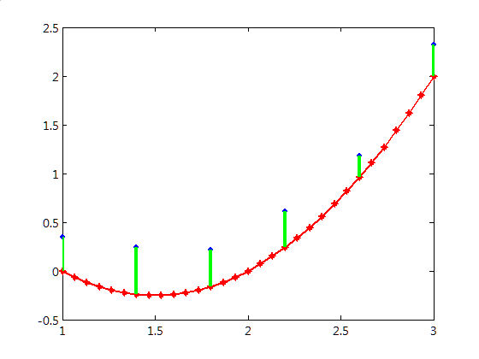
Given some function type y=f(x,p₁,p₂,…,p_{t}) and a collection of m data points (x_{i},y_{i}), i=1,…m,

Slide 10
Analytic Methods of Model Fitting
Investigate three criteria（ criterion(准则)的复数） for fitting curves to a collection of data points.
Chebyshev Approximation（逼近，近似） Criterion
Minimizing the Sum of the Absolute Deviations（绝对残差）
Least-Squares Criterion（最小二乘准则）

Slide 11
Chebyshev Criterion
Minimize the largest absolute deviation （绝对残差）|y_{i}-f(x_{i})| over the entire collection.
That is, determine the parameters （参数） of the function type y=f(x) that minimizes the number

Slide 12
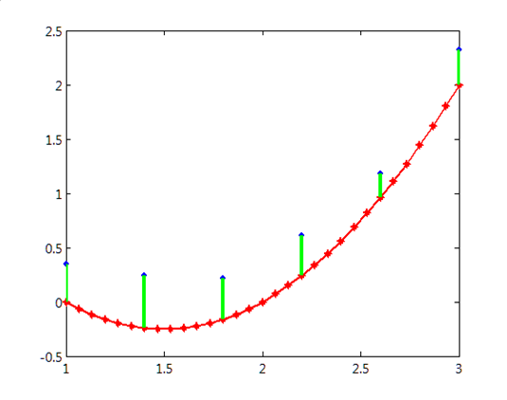
Chebyshev Criterion
i.e.

Slide 13
Least-Squares Criterion

Slide 14
Polynomial Data Fitting with the Least-Squares Criterion

Slide 15
Polynomial Data Fitting with the Least-Squares Criterion

Slide 16
Polynomial Data Fitting with the Least-Squares Criterion

Slide 17
Polynomial Data Fitting with the Least-Squares Criterion

Slide 19
Polynomial Data Fitting with the Least-Squares Criterion
That is, find the parameters a₀,a₁,a₂,…,a_{n} such that

Slide 20
Polynomial Data Fitting with the Least-Squares Criterion
That is, find the parameters a₀,a₁,a₂,…,a_{n} such that

Slide 21
Polynomial Data Fitting with the Least-Squares Criterion

Slide 22
Polynomial Data Fitting with the Least-Squares Criterion
Thus we get the normal equations(正规方程组)

Slide 23
Polynomial Data Fitting with the Least-Squares Criterion
i.e.

Slide 24
Related MATLAB Commands
polyfit
Syntax:
p = polyfit(x,y,n)
finds the coefficients（系数） of a polynomial p(x) of degree n that fits the data, p(x(i)) to y(i), in a least squares sense.
p： a row vector containing the polynomial coefficients in descending powers(降幂)

Slide 25
Related MATLAB Commands
polyval
Syntax:
y = polyval(p,X)
returns the value of a polynomial given its coefficients, p, at the values in X.

Slide 26
Applying the Least-Squares Criterion to transformed data
Fitting a straight line （直线）: y=ax+b
Fitting a power curve（幂函数曲线）: y=βx^{α}
Fitting an exponential curve（指数函数）: y=ae^{bx}

Slide 27
Exercise
Derive(推导) the coefficients k₁,k₂ of the Total Stopping Distance Example by the least squares criterion.

